Slide 1

Generating aesthetic and novel scenes from images using style transfer on NeRF
Caleb Teeter, Chirag Totla, Jerry Zeng, Diptyaroop Maji
CS 674 Project, Spring 2024

Slide 2
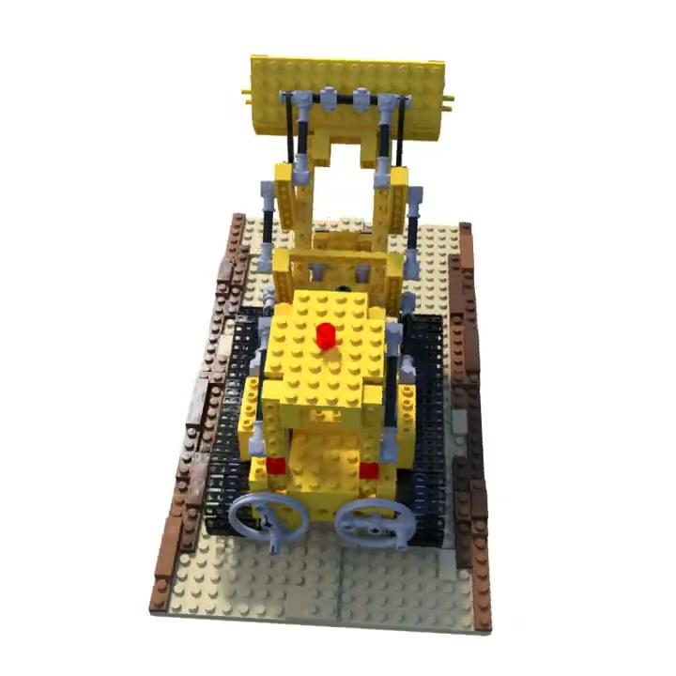
Motivation - NeRF
Photo-realistic image creation
3D renderings without a 3D model

Slide 3
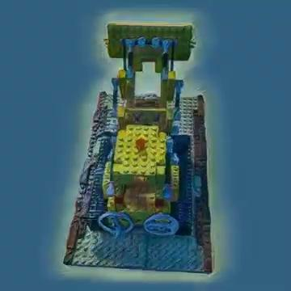
Motivation - Style-NeRF
Animated movies
Augmented/Virtual Reality

Slide 4
Overview of our project
Generate stylized new images (or a novel view) from a set of given images using NeRF & Style transfer.
Compare ordering of Style Transfer and NeRF
Improve the training speed of a popular NeRF algorithm (DVGO¹) at high resolution
Sun et al. "Direct voxel grid optimization: Super-fast convergence for radiance fields reconstruction." CVPR, 2022.

Slide 5
Related work
NeRF
Style transfer
NeRF¹: MLP for prediction
Plenoxels² and DVGO³: MLP replaced with Voxel Grid
InstantNGP⁴: Multi-resolution Hash encoding
Style-flow⁵: Invertible model
StyTR^2⁶: Transformer based approach
Mildenhall et al. "NeRF." ECCV, 2020.
Yu et al. “Plenoxels: Radiance Fields without Neural Networks.” CVPR, 2021.
Sun et al. "Direct voxel grid optimization: Super-fast convergence for radiance fields reconstruction." CVPR, 2022.
Müller et al. “Instant Neural Graphics Primitives with a Multiresolution Hash Encoding.” SIGGRAPH 2022.
Abdal et al. “StyleFlow.” 2020
Deng et al. "StyTr^2: Image Style Transfer with Transformers" CVPR, 2022

Slide 6
Related work
Generating stylized novel views
StyleRF¹: Works directly with radiance field
SNeRF²: Alternates training NeRF on a stylized scene, and using style transfer on novel views
Deng et al. "StyTr^2: Image Style Transfer with Transformers" CVPR, 2022
Nguyen-Phuoc et al. “SNeRF: Stylized Neural Implicit Representations for 3D Scenes.” 2022.

Slide 7
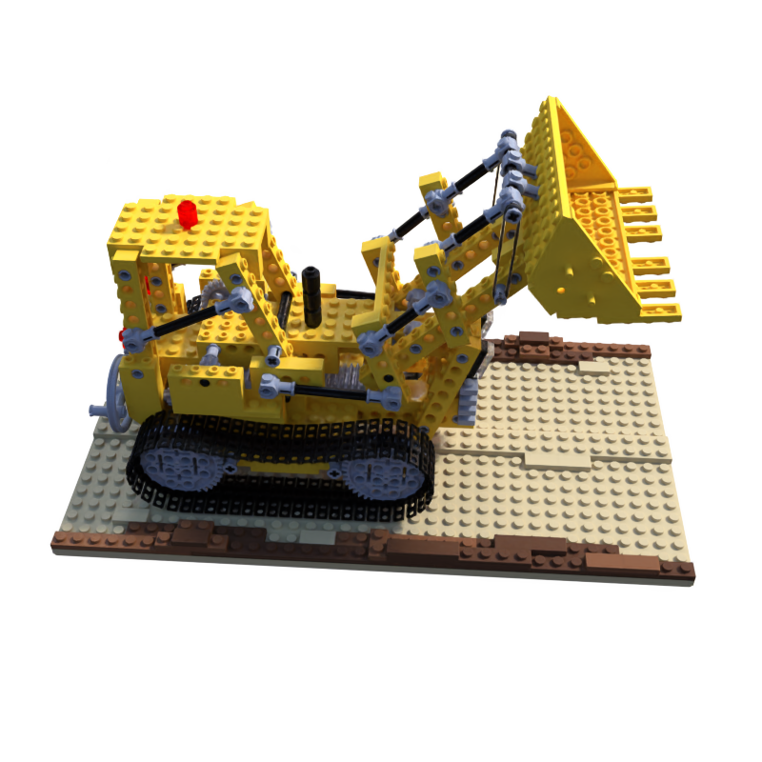
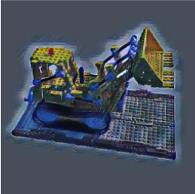
Our project contributions
Design choices for generating images:
Input images
Input images
Style Transfer
NeRF
NeRF
Style Transfer
Stitch into Video
Stitch into Video

Slide 8
Our project contributions
Design choices for generating images.
Modifying DVGO¹ (NeRF component) to improve training speed at high resolution
Hash encoding to decrease overhead of dense voxel grids
Qualitative & Quantitative evaluation of stylized novel views
Testing our NeRF on new dataset
Sun et al. "Direct voxel grid optimization: Super-fast convergence for radiance fields reconstruction." CVPR, 2022.
Deng et al. "StyTr^2: Image Style Transfer with Transformers" CVPR, 2022

Slide 9
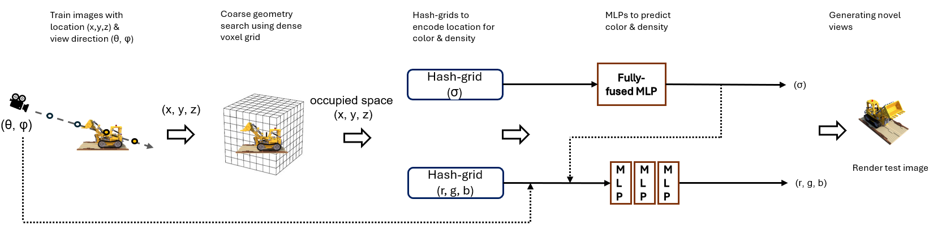
NeRF component
2 stage implementation
Coarse stage using dense voxel grid to fix geometry
Fine stage using hash grid & MLP to generate novel views

Slide 10
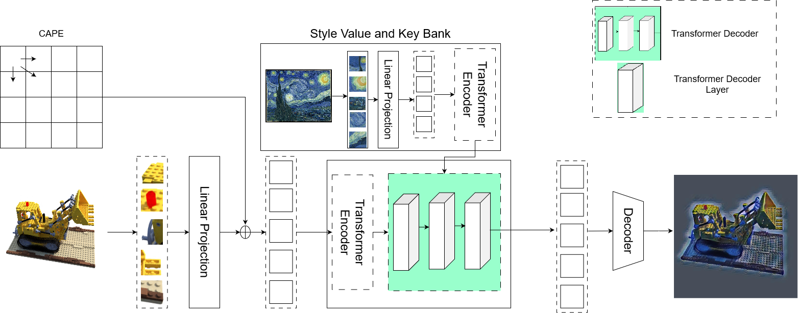
Style Transfer component
Vanilla StyTR^2¹:
25,000 iterations
Batch size 6
Deng et al. "StyTr^2: Image Style Transfer with Transformers" CVPR, 2022

Slide 11
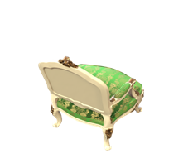
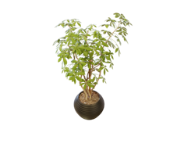
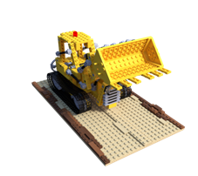
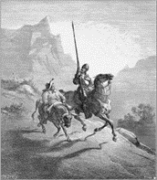
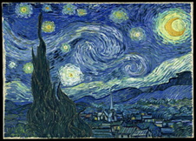
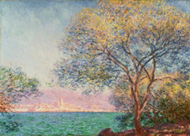
Datasets
NeRF:
NeRF synthetic dataset¹
Style Transfer:
WikiArt²
MS-COCO 2017³
Mildenhall et al. "NeRF." ECCV, 2020.
Phillips et al. “Wiki Art Gallery, Inc.: A Case for Critical Thinking.” Issues in Accounting Education, 2011.
Lin et al. “Microsoft COCO: Common Objects in Context.” 2015.

Slide 12
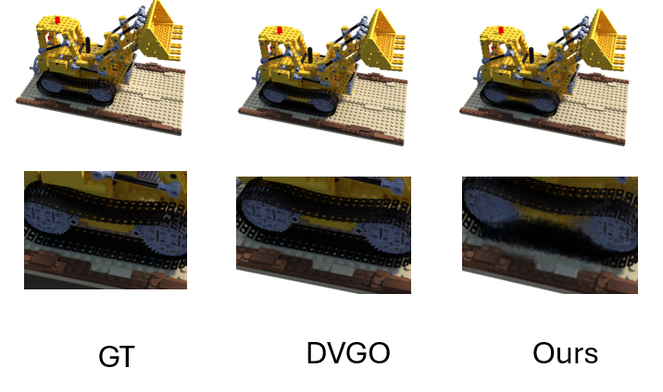
Evaluation: DVGO vs our NeRF implementation
 | DVGO |  | Ours
 | PSNR | Training time (mins) | PSNR | Training time (mins)
Lego | 35.79 | 134 | 31.89 | 36
Ficus | 33.67 | 101 | 33.21 | 23
Chair | 35.50 | 105 | 32.84 | 41
Avg | 34.98 | 113.33 | 32.64 | 33.33
70.6% reduction in training time with only 6.7% performance degradation

Slide 13
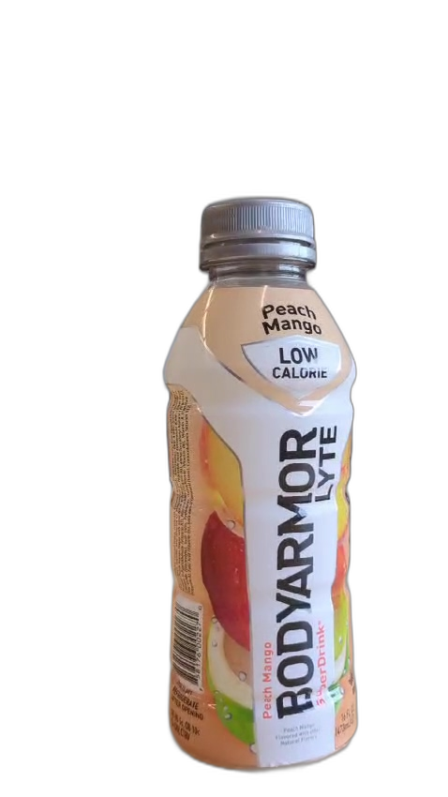
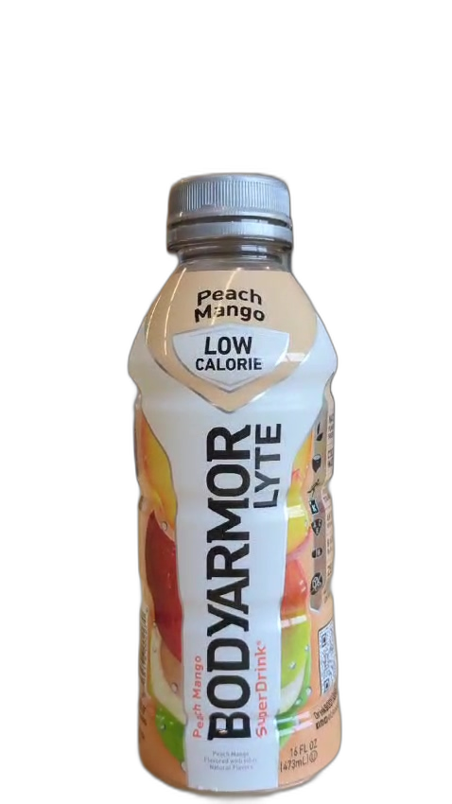
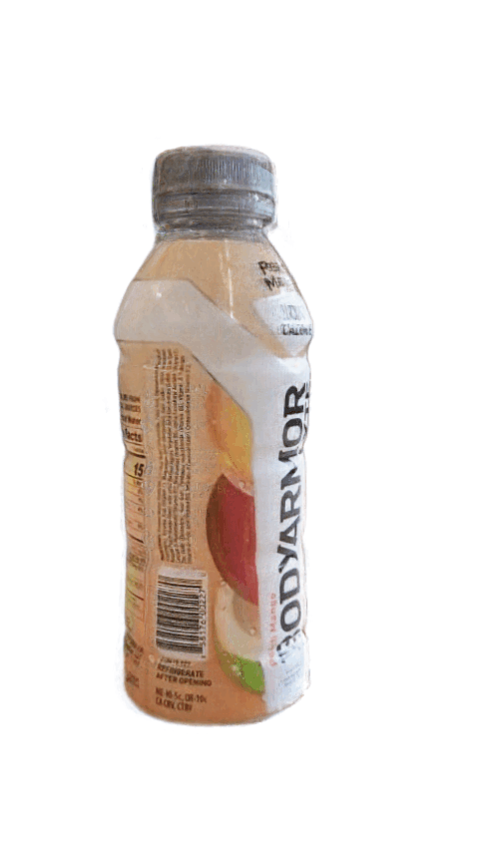
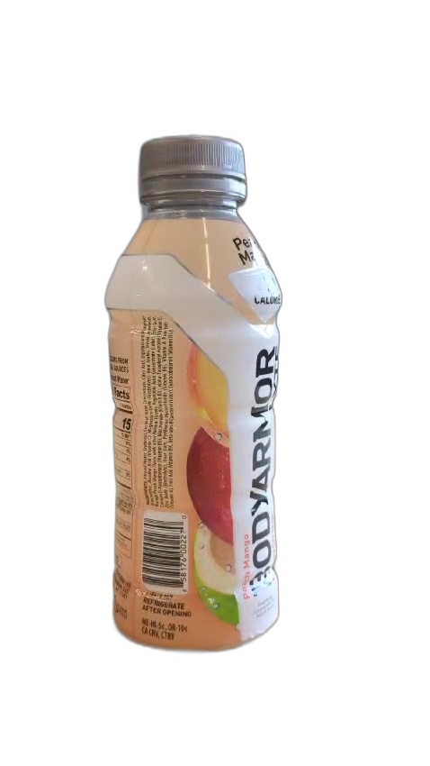
Evaluation: NeRF→ST vs ST→NeRF
Same Style transfer model for both design choices
Same NeRF model for both design choices
Used Style transfer on input images to NeRF vs output images from NeRF
Stitch results into a video

Slide 14
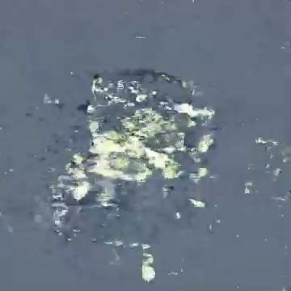
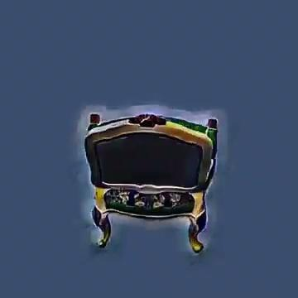
Evaluation: Visual comparison
Style Transfer followed by NeRF
NeRF followed by Style Transfer
ST: StyTR^2¹
NeRF: Our hash-encoding based NeRF implementation
Training time is comparable in both the designs
Yingying et al. "StyTr^2: Image Style Transfer with Transformers" CVPR, 2022

Slide 15
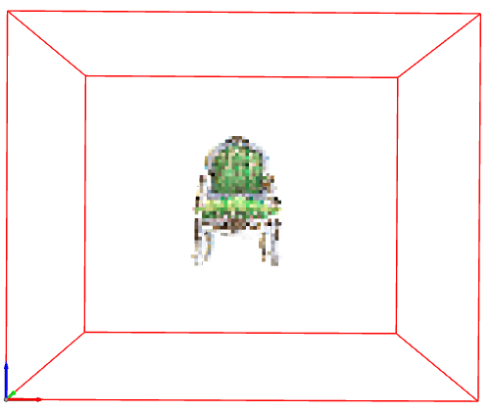
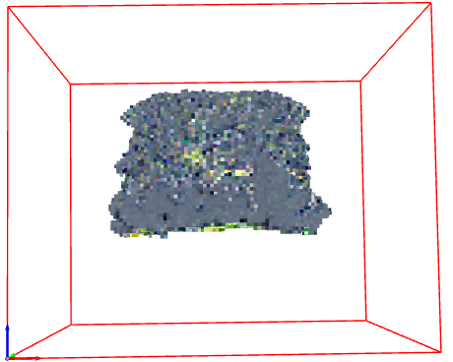
Analysis for reduced performance (ST → NeRF)
Coarse geometry
NeRF → ST
ST → NeRF
Our hypothesis:
Stylized images have more details that the dense grid is not able to capture properly
Fuzzy styles like paintings lead to artifacts in the NeRF

Slide 16
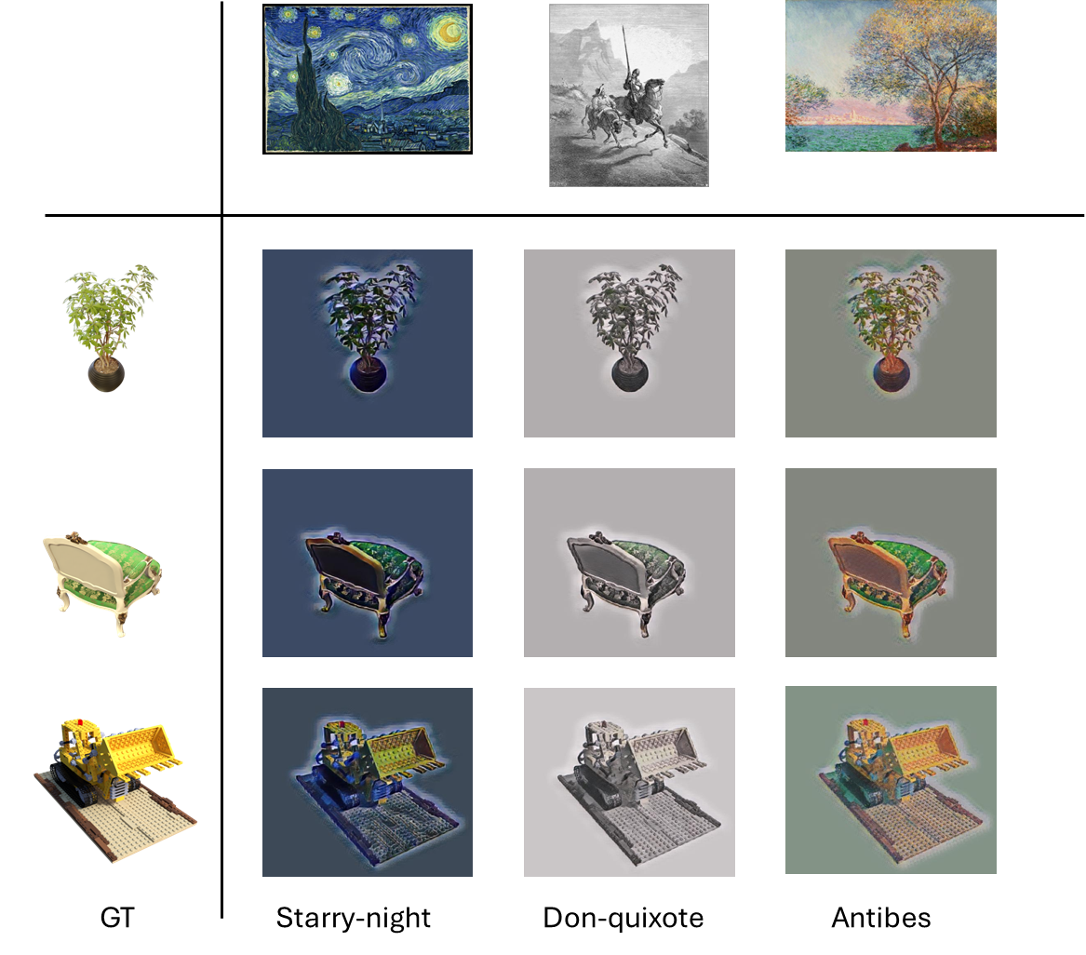
Evaluation: Stylized views
 | Average E¹ Score
NeRF → ST | -11.805
ST → NeRF | -14.495*
Comparison Image | -5.583
*Only evaluated on one object due to time constraints
Yeh et al. "Improving Style Transfer with Calibrated Metrics" WACV , 2020

Slide 17
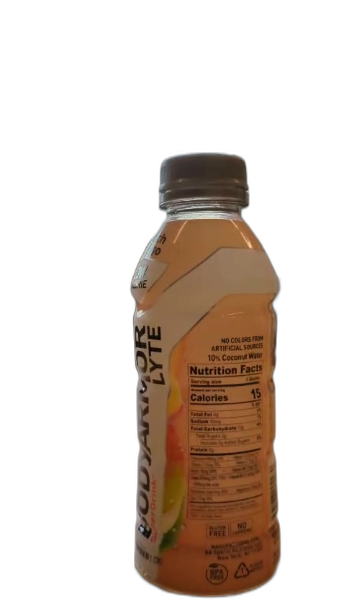
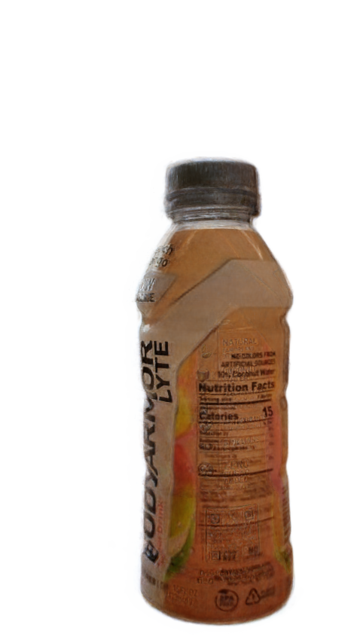
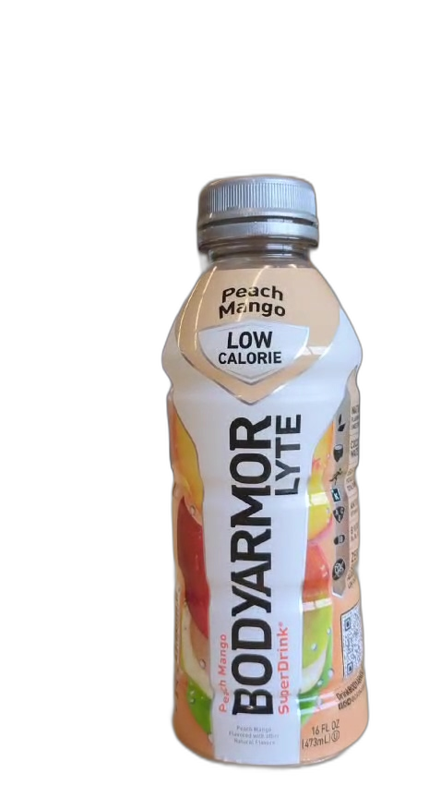
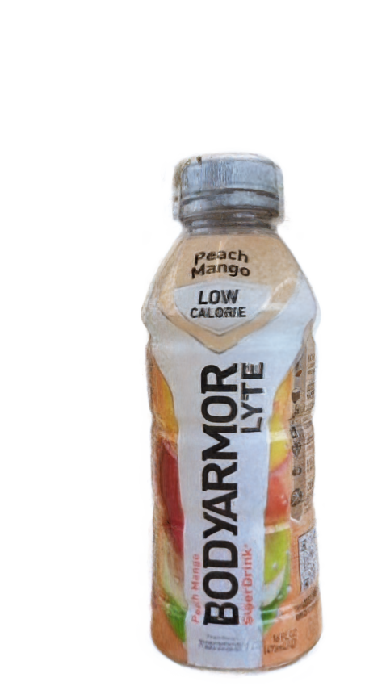
Evaluation: NeRF on a new dataset
NeRF on a new dataset
PSNR: 27.39
Test
Generated
Test
Generated

Slide 18
Discussions & future work
Thank You
More analysis on why ST→NeRF performs worse than NeRF→ST
Ablation studies, replacing dense grid with neural networks
Improving image quality on our NeRF implementation
Hyperparameter tuning
More evaluation (different styles, other datasets)

Slide 19
Backup slides

Slide 20
Generate novel stylized views
NeRF, ST
NeRF → modified DVGO by replacing dense grid with hash grid — results
ST → used some ST technique
To generate stylized views → 2 designs → nerf, st vs st, nerf
We implemented both & checked which is better
Nerf->st is better
We evaluated for 3 datasets → chair, lego & ficus → generated stylized views (3 styles)
qual/quantitative

Slide 21
Challenges
Understanding codebase
Limited GPU resources

Slide 22
Evaluation: NeRF→ST
NeRF followed by Style Transfer
NeRF: ST: StyTR^2²
PSNR: (before ST)
Training time:
Power usage: 25W *
Sun et al. "Direct voxel grid optimization: Super-fast convergence for radiance fields reconstruction." CVPR, 2022.
Yingying et al. "StyTr^2: Image Style Transfer with Transformers" CVPR, 2022.

Slide 23
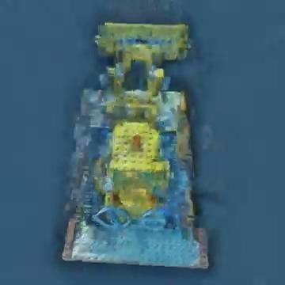
Evaluation
Style Transfer followed by NeRF
ST: StyTR^2²
NeRF: DVGO¹ on stylized images
PSNR: 19.068
Training time: ~2 hours
Power usage: 25W * 2 hours
Sun et al. "Direct voxel grid optimization: Super-fast convergence for radiance fields reconstruction." CVPR, 2022.
Yingying et al. "StyTr^2: Image Style Transfer with Transformers" CVPR, 2022

Slide 24
Related work: Style Transfer
StyTR²: Transformer based
StyTR², Deng et al, 2022

Slide 25
Goal #1: Compare ordering of Style Transfer and NeRF
Input images
Input images
Style Transfer
NeRF
NeRF
Style Transfer
Stitch into Video
Stitch into Video

Slide 26
Goal #2: Improve the efficiency of NeRF
with Hash Encoding
NeRF is computationally expensive to train and run
Hash encoding to decrease overhead on empty space

